Slide 1

ECE 1710: Power Distribution Engineering and Smart Grids
Lecture 12
Dr. Robert Kerestes
University of Pittsburgh
Swanson School of Engineering
Department of Electrical and Computer Engineering
Notes:
Instructions for editing school and department titles:
Select from menu: View > Master > Slide Master
Click on each text area you wish to edit. Text will become editable.

Slide 2
Outline
Outline of Lecture No. 12
Module #1: Voltage Regulation
Module #2: Two-winding Transformer
Module #3: Two-winding Autotransformer

Slide 3
Learning Objectives
Learning Objectives:
Define voltage regulation and identify reasons why regulating voltage is very important for distribution engineers
Define utilization voltage, service voltage, range A and range B
Calculate the a, b, c, d, A and B constants for a two-winding transformer
Define the step-down and step-up autotransformer and discuss how an autotransformer can be constructed from a two-winding transformer
Calculate the a, b, c, d, A and B constants for an autotransformer

Slide 4
Voltage Regulation
Module #1

Slide 5
Voltage Regulation
Module #1
What is voltage regulation?
“In electrical engineering, particularly power engineering, voltage regulation is a measure of change in the voltage magnitude between the sending and receiving end of a component, such as a transmission or distribution line.”
Source: https://en.wikipedia.org/wiki/Voltage_regulation

Slide 6
Voltage Regulation
Module #1
One of a utility’s core responsibilities is to deliver voltage to customers within a suitable range, so utilities must regulate the voltage on distribution circuits due to voltage drops caused by current flowing through the line impedances.
Primary and secondary voltage drop can be allocated as necessary along the circuit to provide end users with suitable voltage.
Voltage regulators in the substation or on feeders can adjust primary voltage. We will discuss voltage regulators, regulation standards and regulation techniques

Slide 7
Voltage Regulation
Module #1
The American National Standards Institute (ANSI) standard ANSI C84.1-1995 for “Electric Power Systems and Equipment Voltage Ratings (60 Hertz)” provides the following definitions for system voltage terms [1]:
System voltage: The root mean square (rms) phasor voltage of a portion of an alternating current electric system. Each system voltage pertains to a portion of the system that is bounded by transformers or utilization equipment
Nominal system voltage: The voltage by which a portion of the system is designated and to which certain operating characteristics of the system are related. Each nominal system voltage pertains to a portion of the system bounded

Slide 8
Voltage Regulation
Module #1
And also:
Maximum system voltage: The highest system voltage that occurs under normal operating conditions, and the highest system voltage for which equipment and other components are designed for satisfactory continuous operation without derating of any kind.
Service voltage: The voltage at the point where the electrical system of the supplier and the electrical system of the user are connected.
Utilization voltage: The voltage at the line terminals of utilization equipment.
Nominal utilization voltage: The voltage rating of certain utilization equipment used on the system.

Slide 9
Voltage Regulation
Module #1
This standard specifies acceptable operational ranges at two locations on electric power systems:
Service voltage - The service voltage is the point where the electrical systems of the supplier and the user are interconnected. This is normally at the meter. Maintaining acceptable voltage at the service entrance is the utility’s responsibility.
Utilization voltage - The voltage at the line terminals of utilization equipment. This voltage is the facility’s responsibility. Equipment manufacturers should design equipment which operates satisfactorily within the given limits.

Slide 10
Voltage Regulation
Module #1
The standard allows for some voltage drop within a facility, so service voltage requirements are tighter than utilization requirements. The standard also defines two ranges of voltage:
Range A — Most service voltages are within these limits, and utilities should design electric systems to provide service voltages within these limits. As the standard says, voltage excursions “should be infrequent.”
Range B — These requirements are more relaxed than Range A limits. According to the standard: “Although such conditions are a part of practical operations, they shall be limited in extent, frequency, and duration. When they occur, corrective measures shall be undertaken within a reasonable time to improve voltages to meet Range A requirements.” Utilization equipment should give acceptable performance when operating within the Range B utilization limits, “insofar as practical” according to the standard.

Slide 11
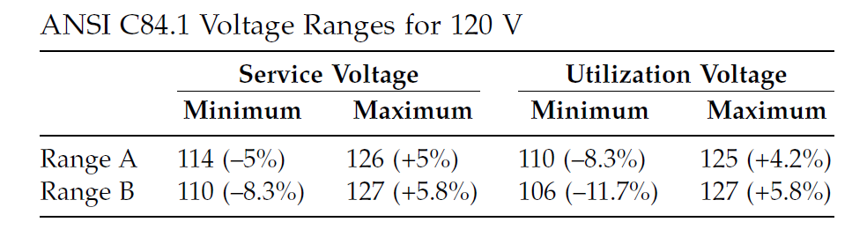
Voltage Regulation
Module #1
The table above shows the most important limits, the limits on low-voltage systems. The table is given on a 120-V base; it applies at 120 V but also to any low-voltage system up to and including 600 V. The main target for utilities is the Range A service voltage, 114 to 126 V.

Slide 12
Voltage Regulation
Module #1
These limits only apply to sustained voltage levels and not to momentary excursions:
Sags - a short duration reduction in rms voltage which can be caused by a short circuit, overload or starting of electric motors.
Switching surges – a short duration increase in rms voltage due to the switching in of inductive and/or capacitive devices
Short duration interruptions – a short duration outage of electric power

Slide 13
Voltage Regulation
Module #1
ANSI C84.1 defines three voltage classes:
Low voltage - 1 kV or less
Medium voltage - greater than 1 kV and less than 100 kV
High voltage - greater than or equal to 100 kV.
Within these classes, ANSI provides standard nominal system voltages along with the voltage ranges.

Slide 14
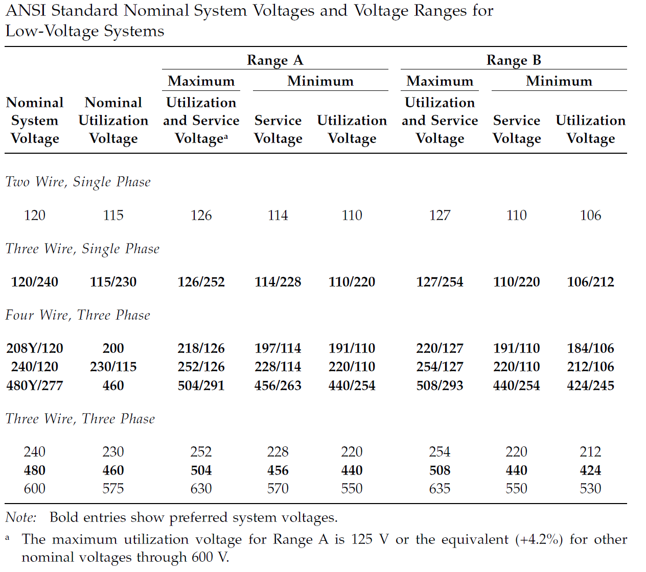
Module #1

Slide 15
Voltage Regulation
Module #1
For low-voltage classes, two nominal voltages are given — one for the electric system and a second, somewhat lower, nominal for the utilization equipment (for low-voltage motors and controls; other utilization equipment may have different nominal voltages). In addition, the standard gives common nameplate voltage ratings of equipment as well as information on what nominal system voltages the equipment is applicable to. As the standard points out, there are many inconsistencies between equipment voltage ratings and system nominal voltages.

Slide 16
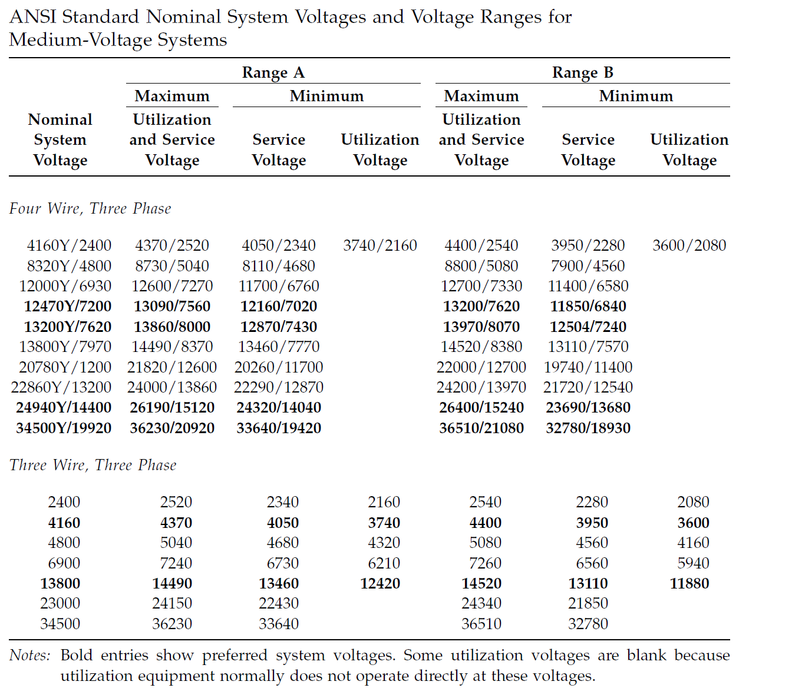
Module #1

Slide 17
Voltage Regulation
Module #1
For medium-voltage systems, ANSI C84.1 gives tighter limits for Ranges A and B. Range A is –2.5 to +5%, and Range B is –5 to +5.8%. However, most utilities do not follow these as limits for their primary distribution systems (utilities use the ANSI service voltage guidelines and set their primary voltage limits to meet the service voltage guidelines based on their practices). The three-wire voltages of 4,160, 6,900, and 13,800 V are mainly suited for industrial customers with large motors. Industrial facilities use motors on these systems with ratings of 4,000, 6,600, and 13,200 V, respectively.

Slide 18
Voltage Regulation
Module #1
Improper voltage regulation can cause many problems for end users. Sustained overvoltages or undervoltages can cause the following end-use impacts:
Improper or less-efficient equipment operation — For example, lights may give incorrect illumination or a machine may run fast or slow.
Tripping of sensitive loads — For example, an uninterruptible power supply (UPS) may revert to battery storage during high or low voltage. This may drain the UPS batteries and cause an outage to critical equipment.

Slide 19
Voltage Regulation
Module #1
Also, overvoltages can cause:
Equipment damage or failure — Equipment can suffer insulation damage. Incandescent light bulbs wear out much faster at higher voltages.
Higher no-load losses in transformers — Magnetizing currents are higher at higher voltages.

Slide 20
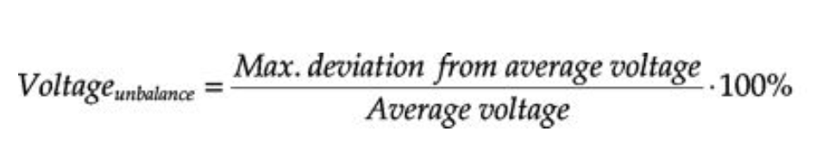
Voltage Regulation
Module #1
In addition to the acceptable voltage magnitude ranges, the ANSI standard recommends that the “electric supply systems should be designed and operated to limit the maximum voltage unbalance to 3 percent when measured at the electric-utility revenue meter under a no-load condition.” Recall that voltage unbalance is defined as:

Slide 21
The Approximate Line Segment Model
Module #3
A common device used to maintain system voltages is the step-voltage regulator. Step-voltage regulators can be single phase three phase.
The regulators and their controls allow the voltage output to vary as the load varies.
A step-voltage regulator is basically an autotransformer with a LTC mechanism on the “series” winding. The voltage change is obtained by changing the number of turns (tap changes) of the series winding of the autotransformer.
An autotransformer can be visualized as a two-winding transformer with a solid connection between a terminal on the primary side of the transformer and a terminal on the secondary.

Slide 22
Voltage Regulation
Module #1
Question: Which of the following are power quality issues which can be corrected by voltage regulation?
Voltage sags due to overloaded an overloaded circuit
Voltage sags due to a self-clearing short circuit
Voltage swell due to excess solar
Voltage swell due to momentary loss of a load, which is quickly reconnected
All can be corrected by voltage regulation

Slide 23
Module #2
Two winding transformer

Slide 24
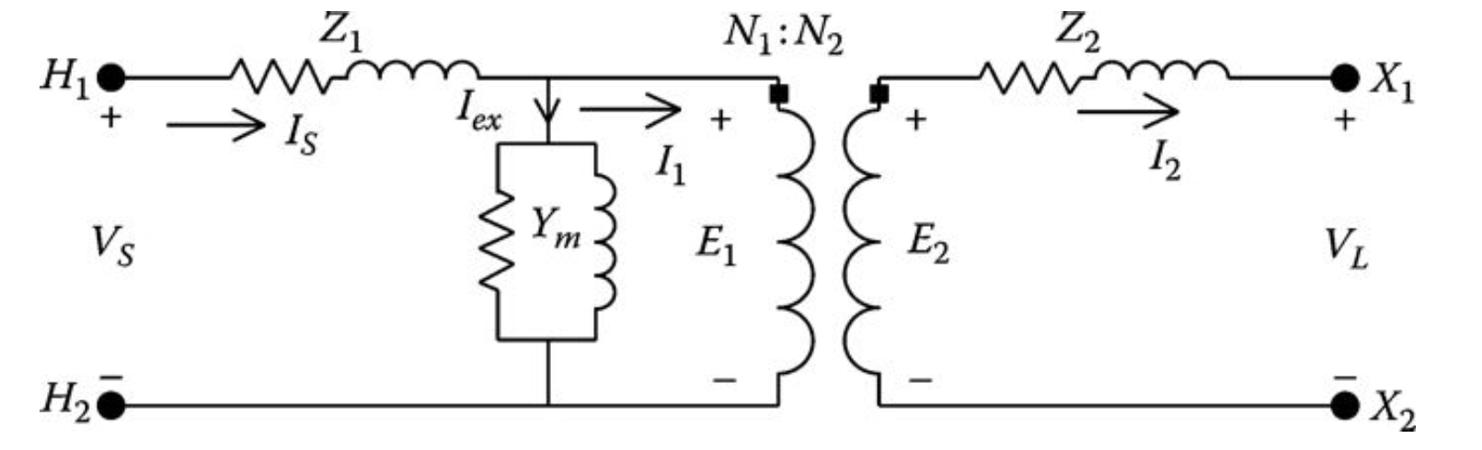
Two Winding Transformer
Module #2
The exact equivalent circuit for a two winding transformer is show below:

Slide 25
Two Winding Transformer
Module #2
Z₁ is high side series impedance made up of
R₁ which is the high side winding resistance
X₁ which is the high side leakage reactance
Z₂ is low side series impedance made up of
R₂ which is the low side winding resistance
X₂ which is the low side leakage reactance
Y_{m} is the shunt excitation admittance
G_{c} is the shunt conductance representing eddy current and hysteresis loss
B_{m} which is the shunt susceptance representing the magnetization loss
H₁ and H₂ are the high side terminal connections
X₁ and X₂ are the low side terminal connections
N₁ and N₂ are the high side and low side winding turns respectively

Slide 26
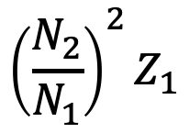
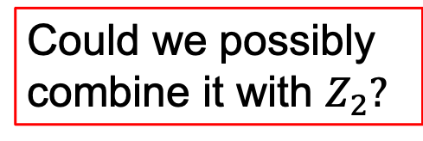
Two Winding Transformer
Module #2
The high side impedance as it is seen from the low side
Seen from here
$${\left(\frac{N_{2}}{N_{1}}\right)}^{2}Z_{1}$$
Could we possibly combine it with $Z_{2}?$
Is equal to

Slide 27
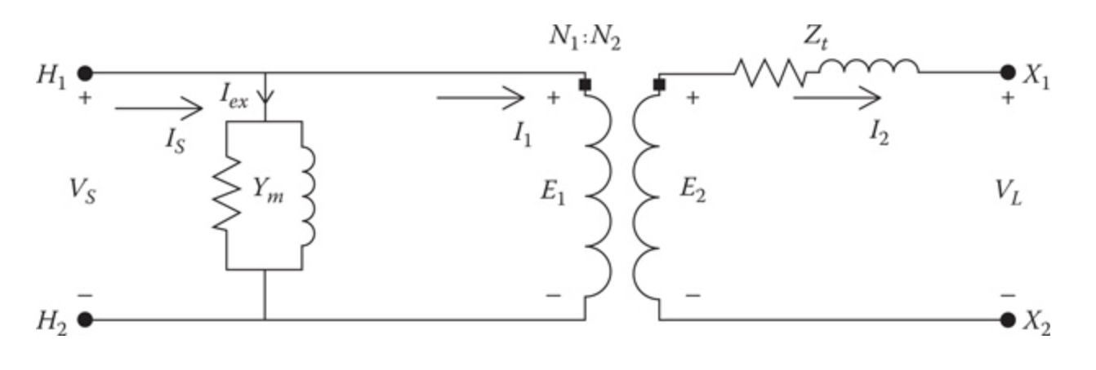
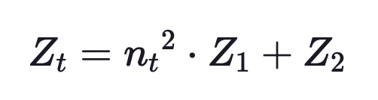
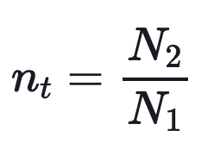
Two Winding Transformer
Module #2
Because the shunt admittance is so small, it’s position in the circuit can be changed without introducing much error as is shown below:
with
where

Slide 28
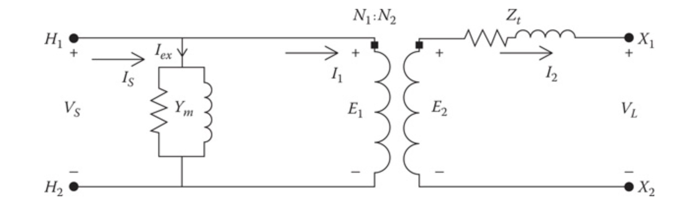
Two Winding Transformer
Module #2
We can derive the a, b, c, d, A, B parameters for a single-phase transformer. These parameters are useful for programming and algorithm development
To better understand the model for the step-regulator, a model for the two-winding transformer will first be developed. Referring to the figure below, the equations for the ideal transformer become:

Slide 29
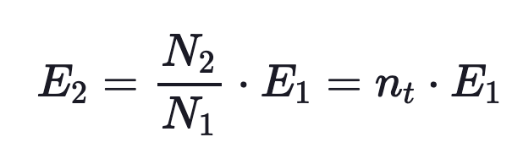
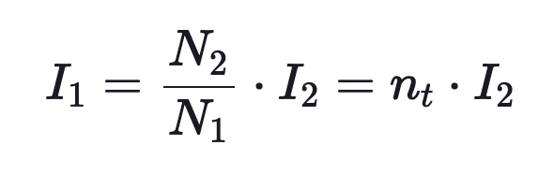
Two Winding Transformer
Module #2
Considering an ideal transformer here

Slide 30
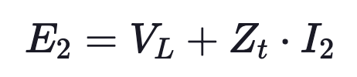
Two Winding Transformer
Module #2
KVL yields around this loop yields

Slide 31


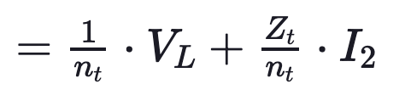
Two Winding Transformer
Module #2
The primary voltage is same as $E_{1}$ so

Slide 32


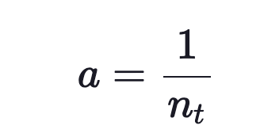
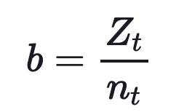
Two Winding Transformer
Module #2
So we have
where

Slide 33
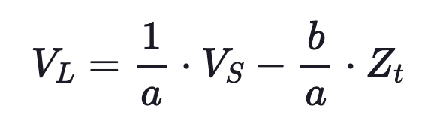
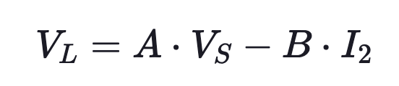
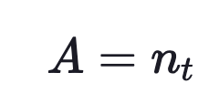

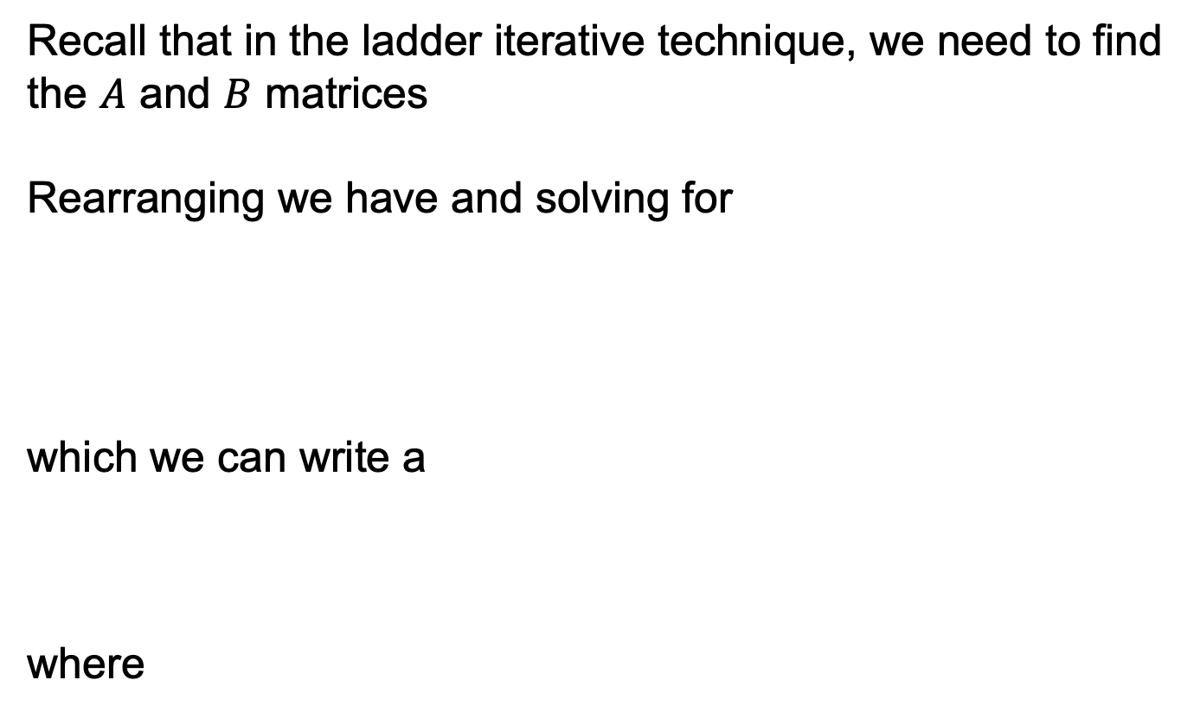
Two Winding Transformer
Module #2
Recall that in the ladder iterative technique, we need to find the $A$ and $B$ matrices
Rearranging we have and solving for
which we can write a
where

Slide 34
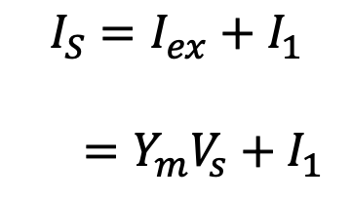
Two Winding Transformer
Module #2
KCL at this node yields
$$I_{S}=I_{ex}+I_{1}$$
$$=Y_{m}V_{s}+I_{1}$$

Slide 35
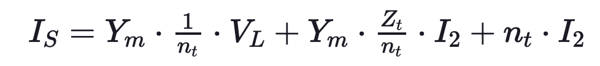
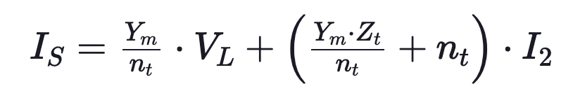
Two Winding Transformer
Module #2
Substituting $V_{S}$ from our previous equation gives us
Reorganizing and collecting terms

Slide 36
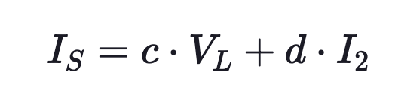
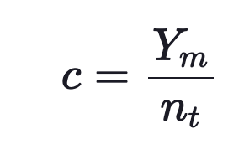
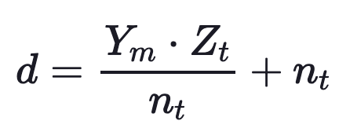
Two Winding Transformer
Module #2
Which gives us
where

Slide 37
Two Winding Transformer
Module #2
Question: A 2400/240 step down transformer has a turns ratio of ______________

Slide 38
Two Winding Transformer
Module #2
Question: If the transformer above has a both high side and a low side impedance of 1, the Z_{t} = ______________ Ω

Slide 39
Module #3
Two Winding Transformer Constants Example

Slide 40
Two Winding Transformer Constants Example
Module #3
Example:
A single-phase transformer is rated 75 kVA, 2400–240 V. The transformer has the following impedances and shunt admittance:
Z₁ = 0.612 + j1.2 Ω (high-voltage winding impedance)
Z₂ = 0.0061 + j0.0115 Ω (low-voltage winding impedance)
Y_{m} = 1.92 × 10⁻⁴ − j8.52 × 10⁻⁴ S (referred to the high-voltage winding)
Determine the generalized a, b, c, and d constants and the A and B constants.
Determine the source voltage and current if the transformer is operated at rated load with a power factor of 0.9 lagging.
Calculate the per-unit impedance and per-unit shunt admittance for the transformer

Slide 41
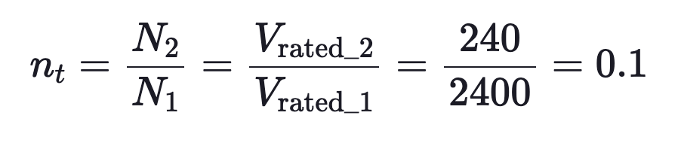
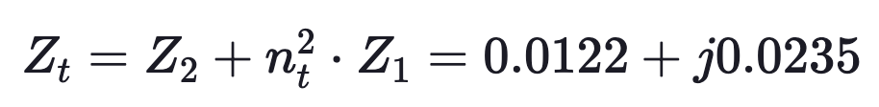
Two Winding Transformer
Module #3
First canclulating the turns ratio
The calculating the impedance referred to the low-voltage side

Slide 42
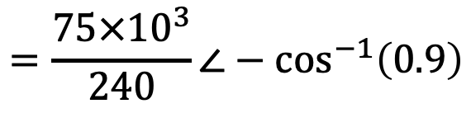
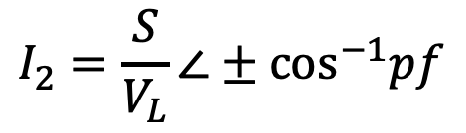

Two Winding Transformer
Module #3
The source voltage and current for the transformer can be found by first determining the load voltage. Using the load ratings we have
$$I_{2}=\frac{S}{V_{L}}∠±{\text{cos}}^{−1}pf$$
$$=\frac{75×{10}^{3}}{240}∠−{\text{cos}}^{−1}\left(0.9\right)$$
$$=312.5∠−25.84°$$
A

Slide 43
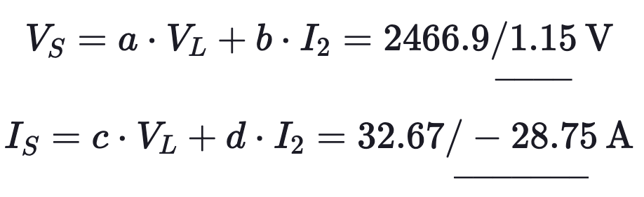
Two Winding Transformer
Module #3
Using the load current and load voltage we can solve for the source current and source voltage using the generalized constants

Slide 44
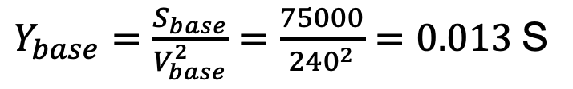
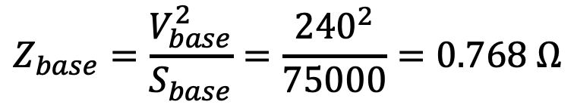
Two Winding Transformer
Module #3
To calculate per-unit quantities, we need base values. We will use the transformer apparent power rating and the voltage rating on the secondary side. Calculating the base values we have
$$Z_{base}=\frac{V_{base}^{2}}{S_{base}}=\frac{{240}^{2}}{75000}=0.768 Ω$$
$Y_{base}=\frac{S_{base}}{V_{base}^{2}}=\frac{75000}{{240}^{2}}=0.013$S

Slide 45
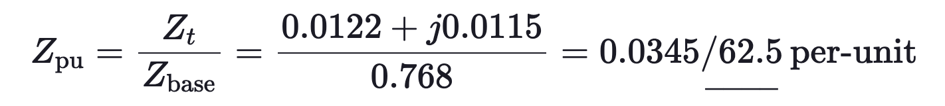
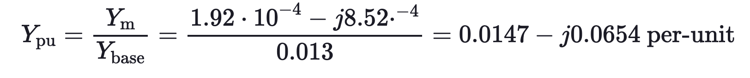
Two Winding Transformer
Module #3
For per-unit impedance and per-unit admittance we must divide the actual impedance and admittance by their respective bases.

Slide 46
Module #3
Two winding autotransformer

Slide 47
Two Winding Autotransformer
Module #3
A two-winding transformer can be connected as an autotransformer.
Autotransformer (Auto-Transformer) is an electrical transformer in which there is one winding, a portion of which is common to both the primary and the secondary circuits.
Autotransformers are both electrically and magnetically coupled.
Connecting the high-voltage terminal H1 to the low-voltage terminal X2 as shown on the next slide can create a “step-up” autotransformer.
The source is connected to terminals H1 and H2, while the load is connected between the X1 terminal and the extension of H2.

Slide 48
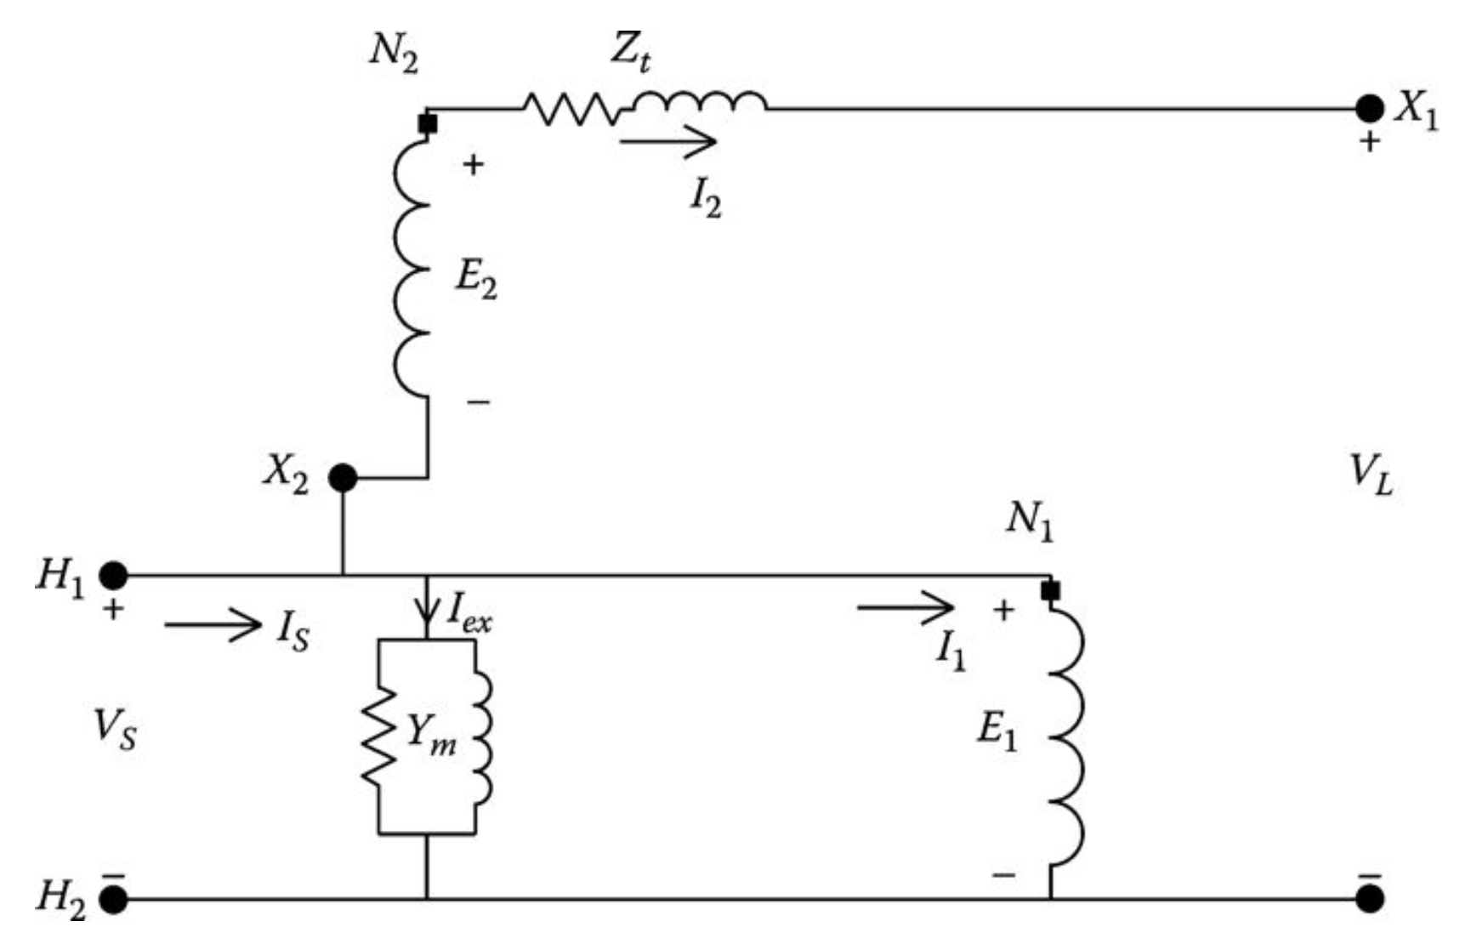
Two Winding Autotransformer
Module #3
“Step-up” autotransformer

Slide 49

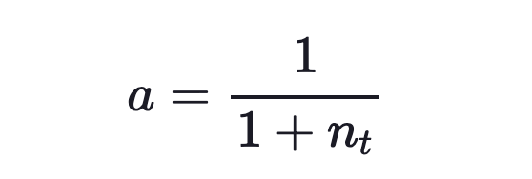
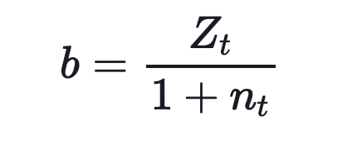
Two Winding Autotransformer
Module #3
The autotransformer has the following a, b, c, d equations (derivation will be left to student):
where

Slide 50

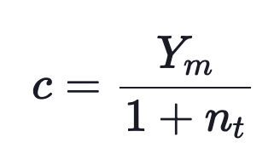
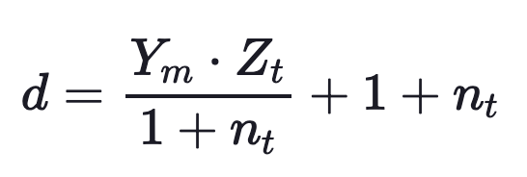
Two Winding Autotransformer
Module #3
and
where

Slide 51
Two Winding Autotransformer
Module #3
The two-winding transformer can also be connected in the “step-down” connection by reversing the connection between the shunt and series winding as shown on the next slide

Slide 52
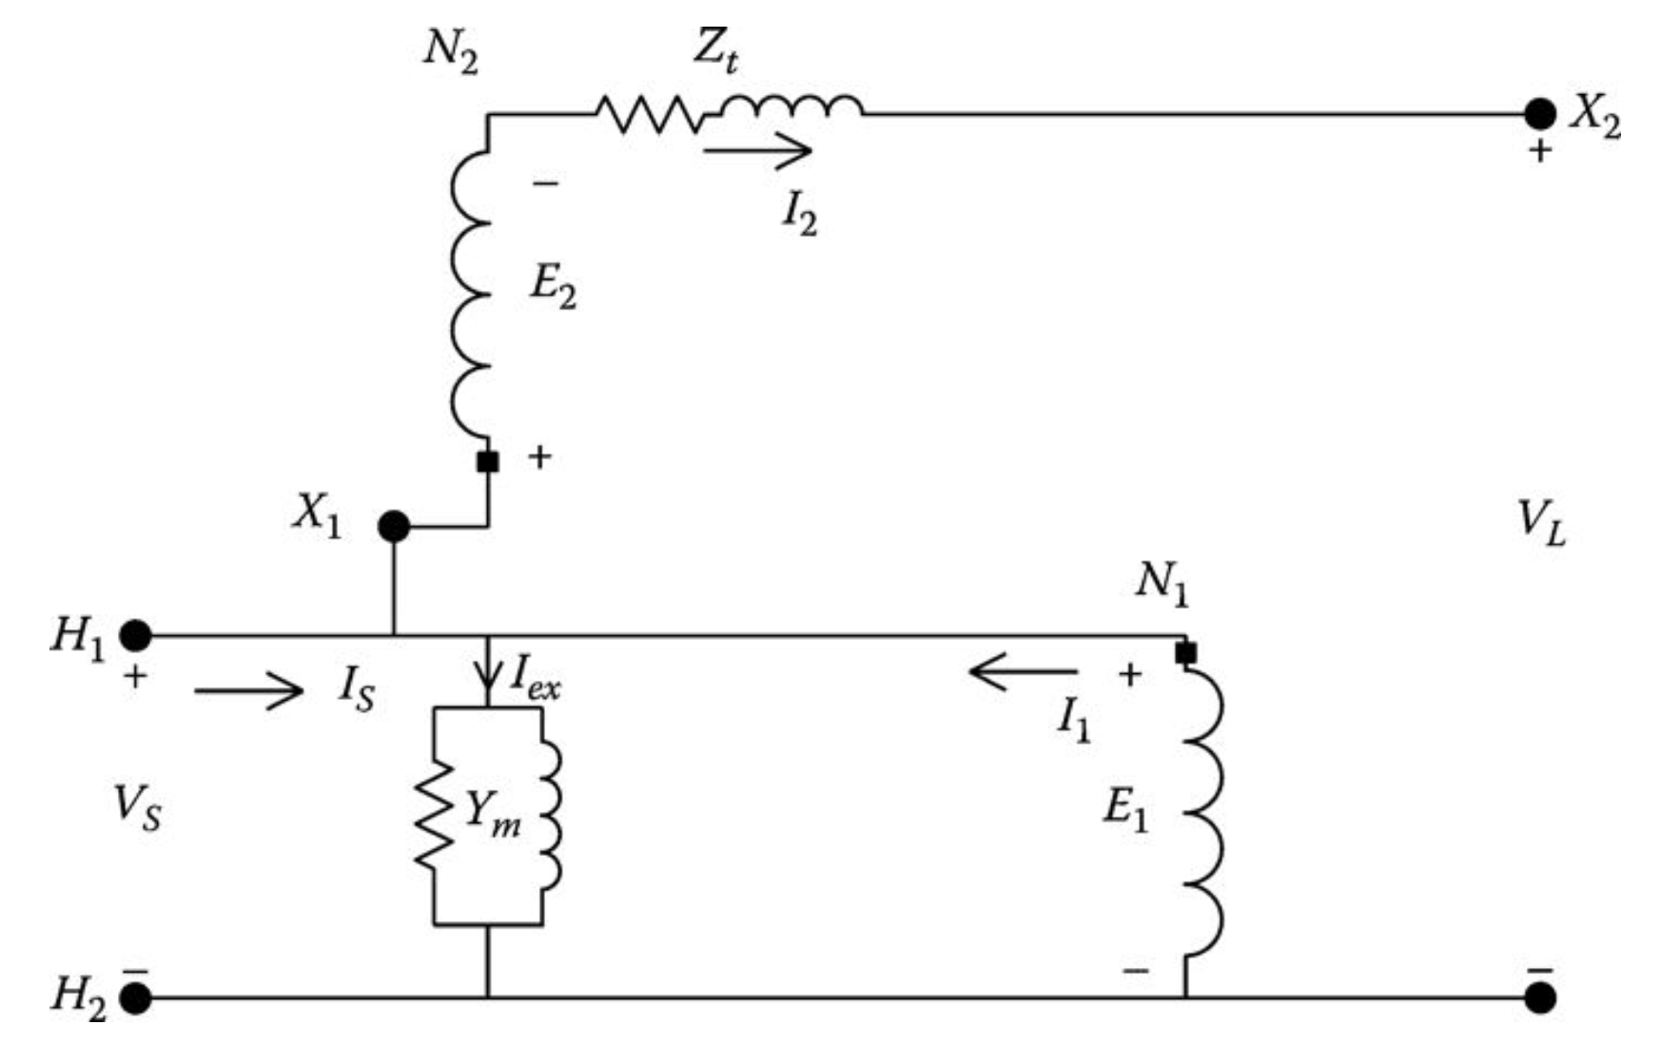
Two Winding Autotransformer
Module #3
“Step-down” autotransformer

Slide 53
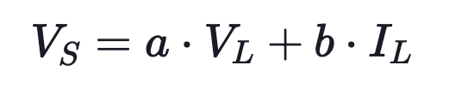
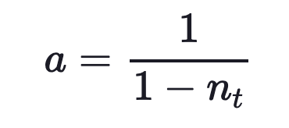
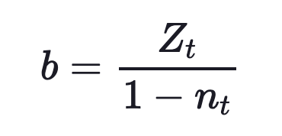
Two Winding Autotransformer
Module #3
The autotransformer has the following a, b, c, d equations (derivation will be left to student):
where

Slide 54
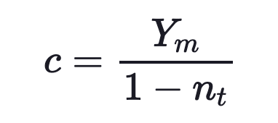
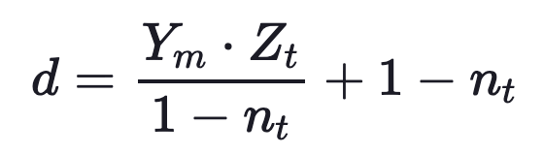
Two Winding Autotransformer
Module #3
and
where

Slide 55
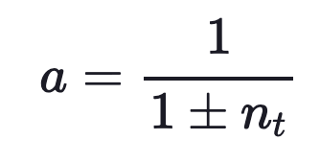
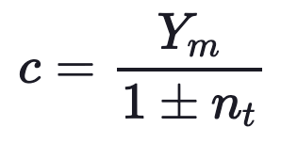
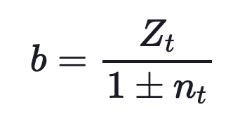

Two Winding Autotransformer
Module #3
The only difference between the definitions of the generalized constants is the sign of the turns ratio n_{t}. Therefore:
where the sign of n_{t} is positive for a “step-up” autotransformer and negative for a “step-down” autotransformer.

Slide 56



Two Winding Autotransformer
Module #3
As with the two-winding transformer, it is sometimes necessary to relate the output voltage as a function of the source voltage and the output current. We can then derive:
where

Slide 57
Module #4
Two Winding Autotransformer Ratings

Slide 58
Two Winding Autotransformer Ratings
Module #4
We discuss the ratings of an autotransformer next. It should be noted that when we connect a two-winding transformer as an autotransformer, we changes its ratings.

Slide 59
Two Winding Autotransformer Ratings
Module #4
The kVA rating of the autotransformer is the product of the rated input voltage V_{S} times the rated input current I_{S} or the rated load voltage V_{L} times the rated load current I_{L}. Define the rated kVA and rated voltages of the two-winding transformer and autotransformer as follows:
kVA_{xfm} represents the kVA rating of the two-winding transformer.
kVA_{auto} represents the kVA rating of the autotransformer.
V_{rated_1} = E₁ represents rated source voltage of the two-winding transformer.
V_{rated_2} = E₂ represents rated load voltage of the two-winding transformer.
V_{auto_S} represents rated source voltage of the autotransformer.
V_{auto_L} represents rated load voltage of the autotransformer.

Slide 60

Two Winding Autotransformer Ratings
Module #4
To calculate the rated kVA for an autotransformer we have
which gives the kVA rating of a two-winding transformer when connected as an autotransformer. For the step-up connection, the sign of n_{t} will be positive, while the step-down connection will use the negative sign.

Slide 61
Two Winding Autotransformer Ratings
Module #4
For the step-up connection, the sign of n_{t} will be positive, while the step-down connection will use the negative sign.
In general, the turns ratio n_{t} will be a relatively small value so that the kVA rating of the autotransformer will be considerably greater than the kVA rating of the two-winding transformer.
Note that one of the benefits of an autotransformer is that it can handle a much greater loading than it could if it was connected as a two-winding transformer.

Slide 62
Two Winding Autotransformer Ratings
Module #4
The per-unit impedance of the autotransformer based upon the autotransformer kVA and kV ratings can be developed as a function of the per-unit impedance of the two-winding transformer based upon the two-winding transformer ratings. Let:
Zpu_{xfm} be the per-unit impedance of the two-winding transformer based upon the two-winding kVA and kV ratings
V_{rated_2} be the rated secondary voltage of the two-winding transformer

Slide 63

Two Winding Autotransformer Ratings
Module #4
We can relate the base impedance of an autotransformer to its two-winding base impedance by

Slide 64


Two Winding Autotransformer
Module #4
Then relating the per-unit impedance of the autotransformer to that its two-winding counterpart:

Slide 65

Two Winding Autotransformer
Module #4
The point being that the per-unit impedance of the autotransformer is very small compared to that of the two-winding transformer. When the autotransformer is connected to boost the voltage 10%, the value of n_{t} is 0.1, and this equation becomes:

Slide 66
Two Winding Autotransformer
Module #4
The per-unit shunt admittance of the autotransformer can be developed as a function of the per-unit shunt admittance of the two-winding transformer. Recall that the shunt admittance is represented on the source side of the two-winding transformer. Let
Ypu_{xfm} be the per-unit admittance of the two-winding transformer based upon the transformer ratings
Ypu_{auto} be the per-unit admittance of the autotransformer based upon the autotransformer ratings

Slide 67


Two Winding Autotransformer
Module #4
The per-unit admittance of the autotransformer is related to its two-winding configuration is:

Slide 68

Two Winding Autotransformer
Module #4
This shows that the per-unit admittance based upon the autotransformer ratings is much smaller than the per-unit admittance of the two-winding transformer. For an autotransformer in the raise connection with n_{t} = 0.1, this equation becomes:

Slide 69
Two Winding Autotransformer
Module #4
If a detailed analysis of the autotransformer is desired, the series impedance and shunt admittance should be included.
However, these values are very small, and when the autotransformer is to be a component of a system, very little error will be made by neglecting both the series impedance and shunt admittance of the equivalent circuit.

Slide 70
Two Winding Autotransformer
Module #4
Question: (True of False) An autotransformer has windings which are electrically coupled but magnetically decoupled

Slide 71
Two Winding Autotransformer
Module #4
Question: (True of False) An autotransformer can step voltage up or down by a small amount based on the nature of its winding connection

